Slide 1
Design Review #2
Team B
Advisor
Park HaeWon
TA
Bae JunHyuk
Members
Jeong WooJin
Jang SeungHeun
Bereket Yisehak
Choi YoungSuk
Jeong SeoHee
Kim GaHyun
Sabuhi Mikayilov
Notes:
Hi, this is team B. And I’m the presenter 최영석. Today I’ll present on Design Review #2.

Slide 2
Table of Contents
Problem Definition
Hardware Design
Software Design
Notes:
These are our table of contents.
We’ll first start by problem definition then move on to software design part.
Finally we’ll explain our Software Design and end the presentation

Slide 3
Problem Definition
Notes:
So I’ll talk about problem definition now.

Slide 4
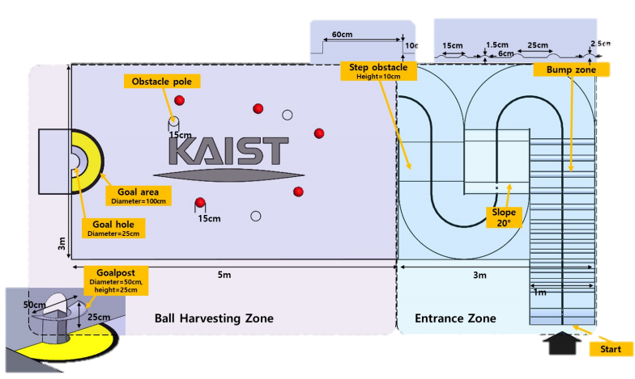
Problem Definition
Step Obstacle
Overcome the high step
Pass the entrance zone, and harvest 5 balls
Entrance Zone
Line Tracing
Goal Area
Move gripper upward to dump ball
Entrance Zone
Climb up step
&
Overcome vibration from bumps
Goal Area
Detect green ball
Ball Harvesting Zone
Use gripper to collect ball
Ball Harvesting Zone
Detect red ball
&
Avoid obstacle
Notes:
The map and the description in this slide shows the mission we have to accomplish.
In short, we have to pass the entrance with three challenges, bump, slope, and step obstacle.
And then we should harvest 5 balls in the ball harvesting zone.

Slide 5
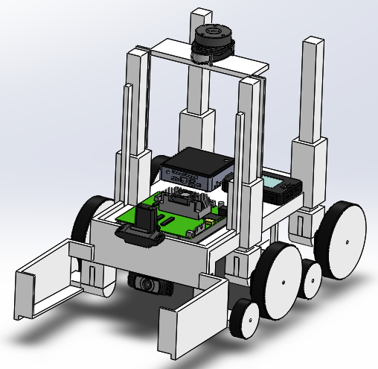
Problem Definition
Design Goal
Design Goal : Safety!
Safely overcome step
2. High accuracy of ball harvesting
3. Short running time
Notes:
To conduct the objectives successfully, we set our No. 1 as a stability.
When we tested the given missions with first model, it was not stable and sometimes it failed to go over the obstacles.
So we thought minimizing the error is the most important.
In particular, we focused on step obstacle because we failed at the step mostly.
And we made it harvest balls 1 by 1 with gripper, this made algorithm very simple, so that we could get high accuracy on ball harvesting.

Slide 6
Hardware Design
Notes:
Now, I’ll move on to hardware design part.

Slide 7
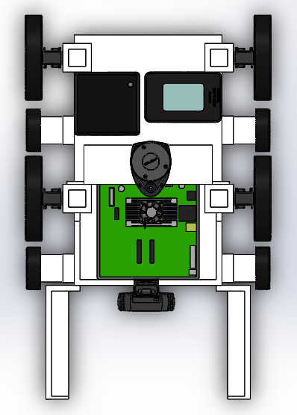
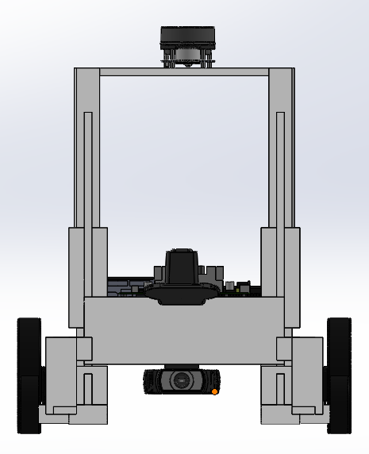
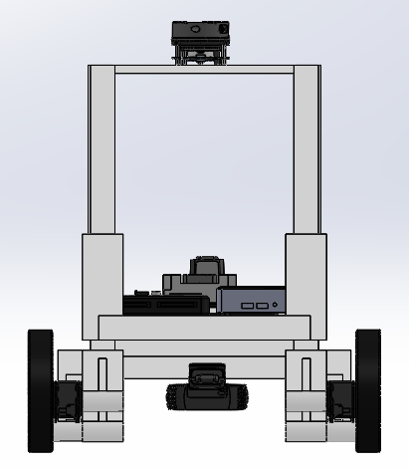
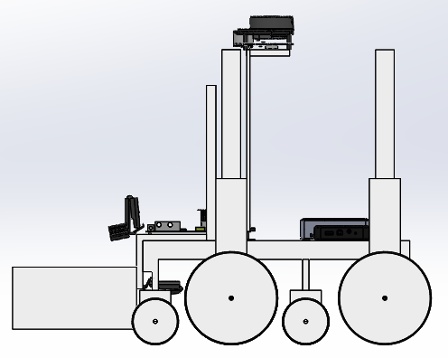
Hardware Design
Overall Design
Top view
Front
Back
Side
mass : 7574.34g, width : 433mm, length : 675mm height : 525mm
center of mass(x,y,z) : (13.55,0.00,148.13)
*based on simulation model
Notes:
This is the overall design of our team’s robot.
As you can see, the picture below are top, front, back and side view of our robot.
The robot weighs 7.5kg and length is about 0.6m.
It’s center of mass is 0.15m in the z-axis which is relatively low.
And it was designed to be symmetric with respect to the x-axis.

Slide 8
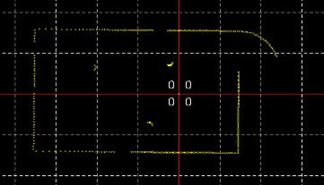
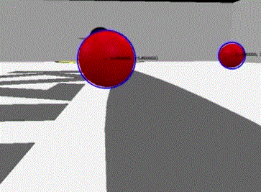
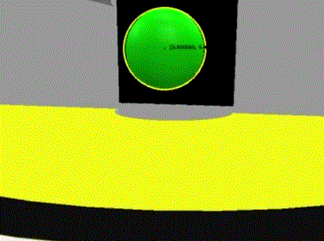
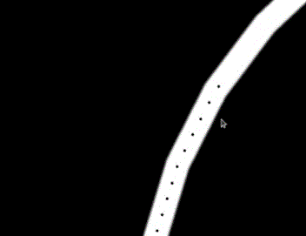
Hardware Design
Device Arrangement
Lidar
Detecting walls and environment in harvesting zone
Webcam 1
search for balls and goal post
Webcam 2
Line-tracing
Notes:
This slide shows how the devices are set up in our robot.
We used two webcams and one lidar in our model.
Webcam1, that is setup in the bottom part of the robot is used to detect balls and the goal post. Webcam2, that is setup in the top part of the robot is used for line tracing.
And the lidar was used to detect ball harvesting zone environment.
Since it has to see all the surroundings, it was placed at the topmost part of the robot.

Slide 9
Hardware Design
Passive/Active Wheel
Passive Wheel
Active Wheel
Passive/Active Wheel
Out of 8 wheels, only 4 big wheels are active wheels. Other 4 small wheels are passive wheels. This design was done to successfully overcome bumpers and reduce the number of motors.
Notes:
In this slide, I’ll talk about the wheel system.
We have 8 wheels total, while 4 of them are drive wheels and the others are passive wheels.
We designed wheels like this because we only need 4 motors for movement, but we need 4 more wheels while going over the step obstacle.
And we added 4 linear actuators right above the 4 big wheels.
Along this linear actuators, the car body can move upward or downward freely.

Slide 10
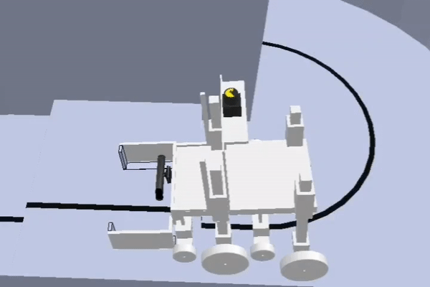
Hardware Design
Step Obstacle Overcome: Wheel Lifting System
Car Lifting
1st and 3rd legs are linked with linear actuator.
Put the first wheel on the step
Lift second wheels
Put second, third wheels on the step
Lift rear wheels and GO!
Stable &&
High Success Rate
Notes:
The wheel system was focused on going over the step obstacle, and this is why we designed 8 wheels and 4 linear actuators.
When the robot faces step in the entrance zone, it puts its front wheels on the step.
And then it lifts the second wheels while the wheel height becomes same with aside wheels.
Next, the robot puts second, third wheels on the step.
Finally, if the robot lifts last wheels and go straight, it can go over the step obstacle.
With this algorithm, we succeeded everytime we tried very stably.

Slide 11
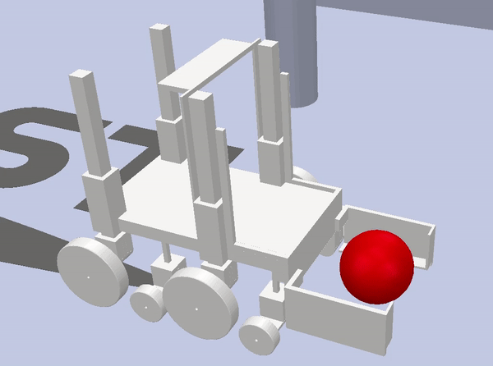
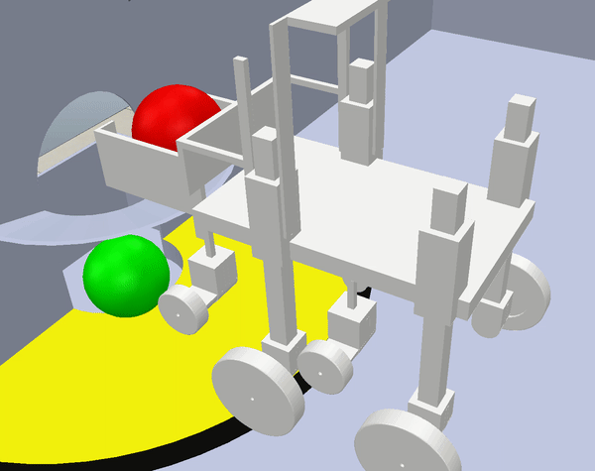
Hardware Design
Ball Harvesting Method: Gripper
Ball Harvesting
Ball Dumping
Gripper
We can harvest ball using the gripper. Then, by elevating the gripper in the goal area, we can dump the ball into the goal post
Notes:
To collect the balls, we selected gripper model.
We designed this model, because this is the simplest model which can help reducing size and weight.
When the robot notices the red ball, it holds the ball and move to the goal zone.
when the robot reaches the goal zone, it elevates the gripper and opens it to dump the ball to goal.
You can check this mechanisms out by this short video clips in the slide.

Slide 12
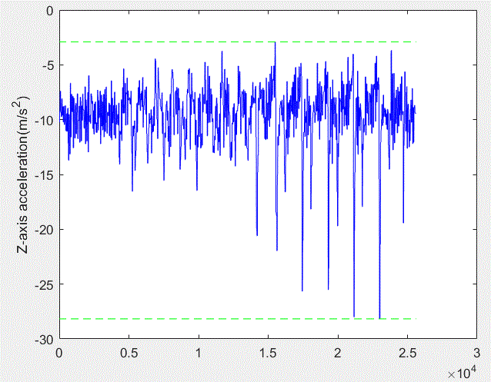
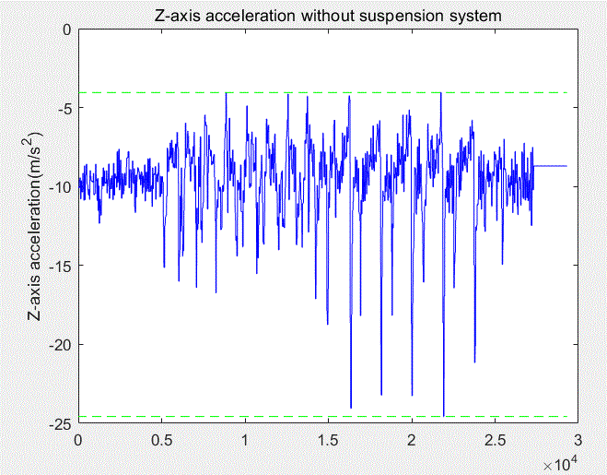
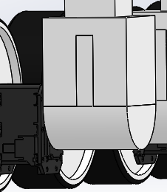
Hardware Design
Vibration Control: Simple Shock Spring Damper System
Without Suspension
With Suspension
k = 200N/m, c = 34.12Ns/m
Simple Shock Spring Damper System
Vibration control system applied to 4 wheels of the model. Designed as prismatic joint.
Notes:
This is our team’s vibration model.
We used simple shock spring damper system.
Since we are using only 4 wheels out of 8 wheels in bumper zone, we placed the spring and damper to only 4 wheels.
These two graphs are z-axis acceleration data from imu sensor, with and without spring-damper system.
When we applied these k, c values, the maximum peak of z-axis reduced when we used the spring-damper system.

Slide 13
Software Design
Notes:
Next part is software.

Slide 14
1. Line Tracing
Lane_Detect
/position
: Detect line and send line shape data
Line_Trace_Node
: Control car behavior
Depth_Node
/step_detect
: Detect step obstacle
Notes:
For the entrance zone, we have 3 nodes.
lane detect node observe lane and tell the car should go straight, left, or right.
depth_node detect step obstacle with depth camera
and line_trace_node controls the car behaviour with all those datum.

Slide 15

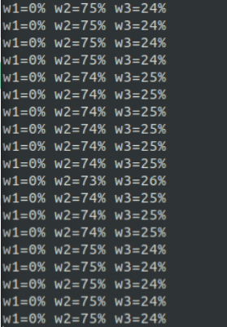
1-1. Line Tracing
w1
w2
w3
w1, w2, w3 :
Distribution percentage of black pixels.
Algorithm
Divide image into three parts
Check the number of black pixels in each parts
Notes:
I’ll explain the line tracing algorithm first.
Line detecting node counts the number of the black pixels in the image.
And divide the image into three parts, left, center, and right, and compare the number of the black pixels in each area
W1, w2, and w3 are distribution percentage of black pixels in each area, and algorithm was written based on this values.

Slide 16
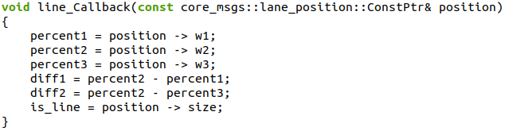
1-1. Line Tracing
w1
w2
w3
Algorithm
3-1. w2 > 80% : straight
3-2. w1 > w3 : turn left
3-3. w1 < w3 : turn right
Notes:
If w2 is larger than 80%, car goes straight.
If w2 is smaller than 80%, compare w1 and w3 value and go to the bigger direction.
In this case, w1 is 0%, w2 is 75%, and w3 is 25%, this car goes to the right.

Slide 17
1-1. Line Tracing
w1
w2
w3
Drawback
Impossible to reflect
the shape of road
Solution
Check right in front of the car
Notes:
However this algorithm have a drawback that it cannot distinguish the road shape.
So when we did test running, sometimes it misunderstood the road shape and went to the wrong way.
To solve this problem, we put the camera above the gripper and made it to see right in front of the robot
This made shape of the road is not important, so it followed lane perfectly.

Slide 18
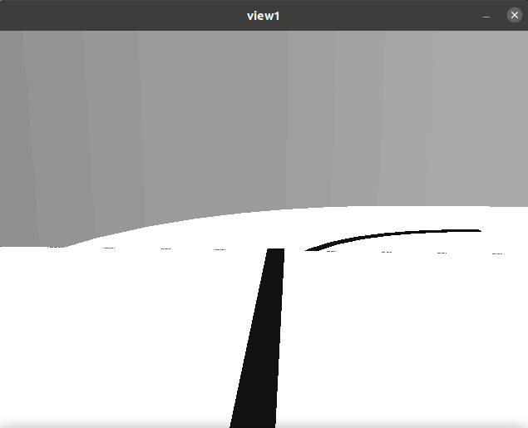
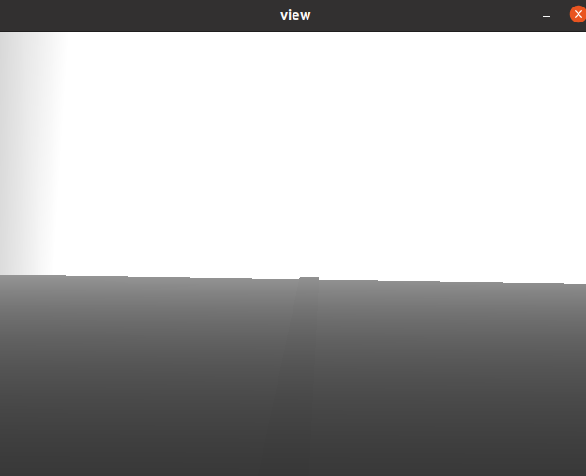
1-2. Step Obstacle
Algorithm 1
Check if there is a lane
Algorithm 2
Check mean depth value of upperside
Algorithm 3
Check mean depth value of lowerside
Notes:
This is how we detect the step obstacle.
This is sample image of depth node, and we identify the step obstacle with those 2 images.
In the first image, the node check if the car is on the lane, not to confuse the wall as step.
In the second image, we check depth of the upper side to check if upperside is opened, not to confuse slope as a step.
And we check mean depth value for 5 points at the bottom, to check the shape of step.

Slide 19
2. Ball Harvesting
Ball_Detect
/position
: Detect balls and send ball position data
Data_Integration
Coppeliasim
/LWheel_joint
/RWheel_joint
/legs_joint_pos
/grip_joint_pos
/el_grip_joint_pos
: Control car behavior
Lidar_Node
/lidar_x
/lidar_y
/wall
: Detect lidar (x, y) position
Notes:
Next part is ball harvesting.
Ball harvesting also have 3 nodes, one for ball detection,
another one for obstacle detection with lidar,
and the other one for car behaviour control.

Slide 20
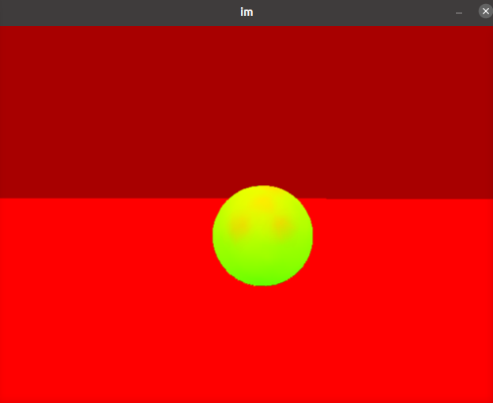
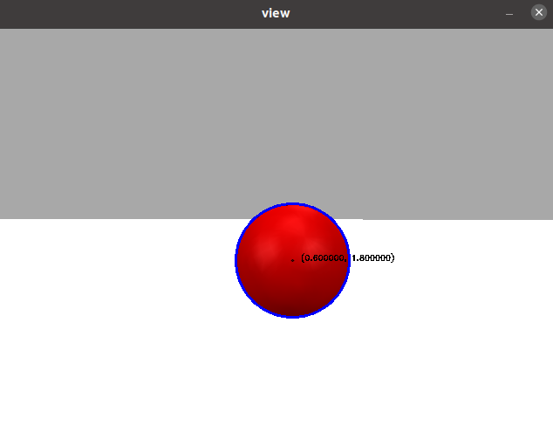
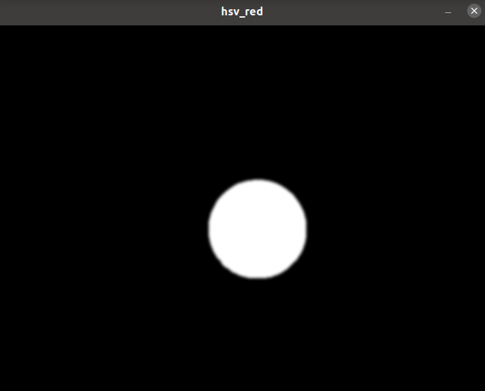
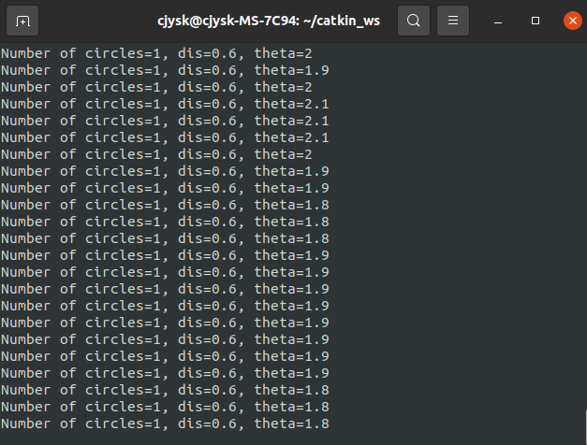
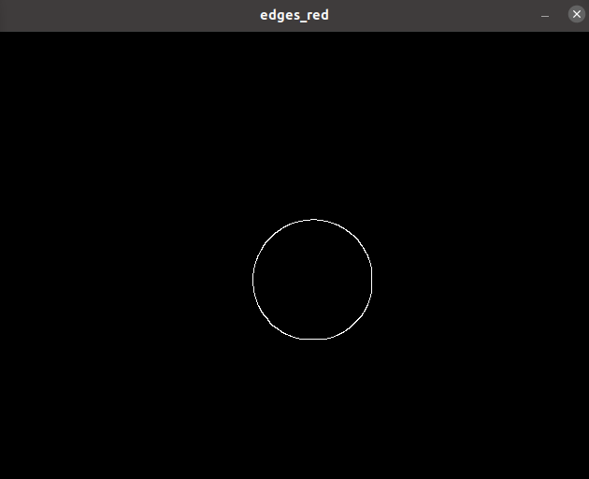
2-1. Ball Detecting
Step 1.
Convert image into HSV
Step 4.
Draw circle
Step 2.
Edge detection with
Canny edge detector
Step 5.
Calculate distance &
angle from camera center
Step 3.
Detect contours &
fit circles to contours
Notes:
This is our ball detecting algorithm
It finds contour of red pixels and draw circle.
Based on that circle drawings, it calculate the number of detected balls, angles, and distances of each ball, and return them

Slide 21
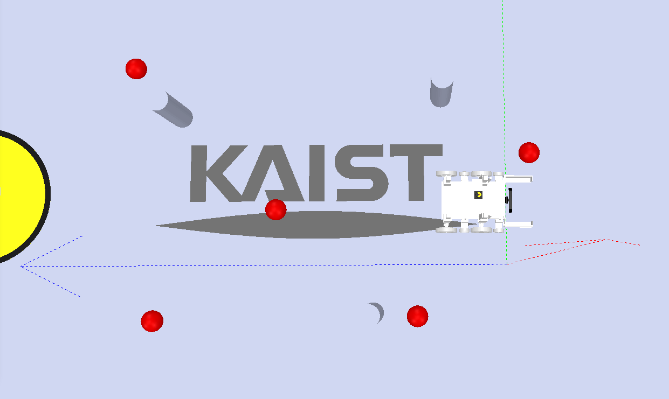
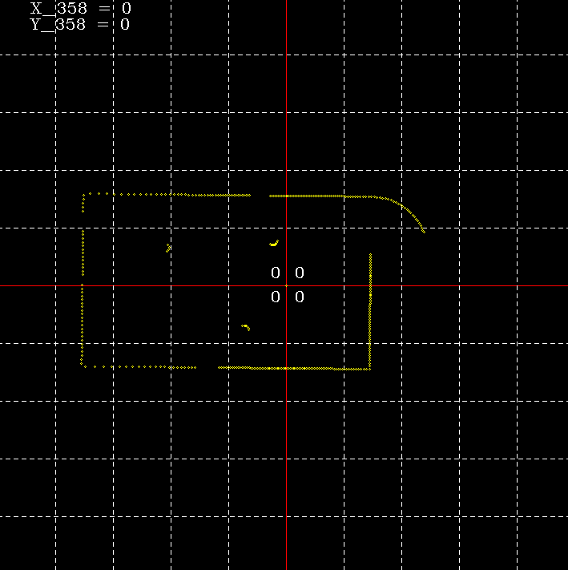
2-2. Lidar Detection
Find Pole
Find discontinuous range points to detect pole
Notes:
This slide is about lidar data processing.
In the lidar_node, lidar detects wall and obstacles with several range and angle data.
To detect the poles, we found some points that are discontinuous with its neighbors.
If the distance differences with its neighbour point is bigger than 0.7,
it saves that point as one edge of the pole.
And after that, we can find another discontinuous point, which is another edge of the pole
We consider the points that are in between the two points as pole so that we can find pole location.

Slide 22
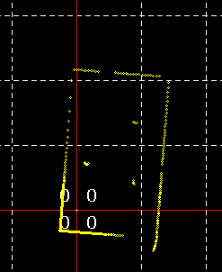
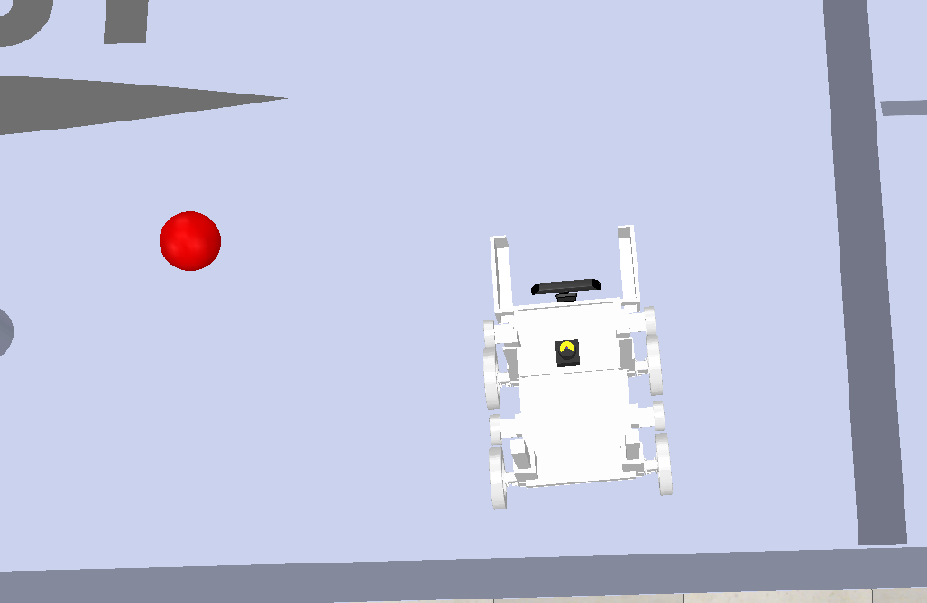
2-2. Lidar Detection
2.54
3.90
1.05
4.32
0.68
Check Distances
Check 8 directions of distance to the wall
0.59
0.69
0.45
Detect Wall
Find close points which are not the poles
Notes:
lidar is also used to find wall distances.
lidar continuously calculates distances to the 8 directions of the car.
If the calculated distance is about a pole, not a wall, car just ignore that direction because it is already checked in the obstacle detection.
We use this data to check which side is close to the wall, and this is essential for escaping the corner.

Slide 23
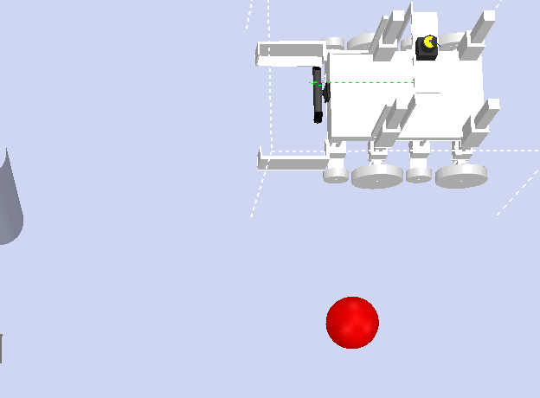
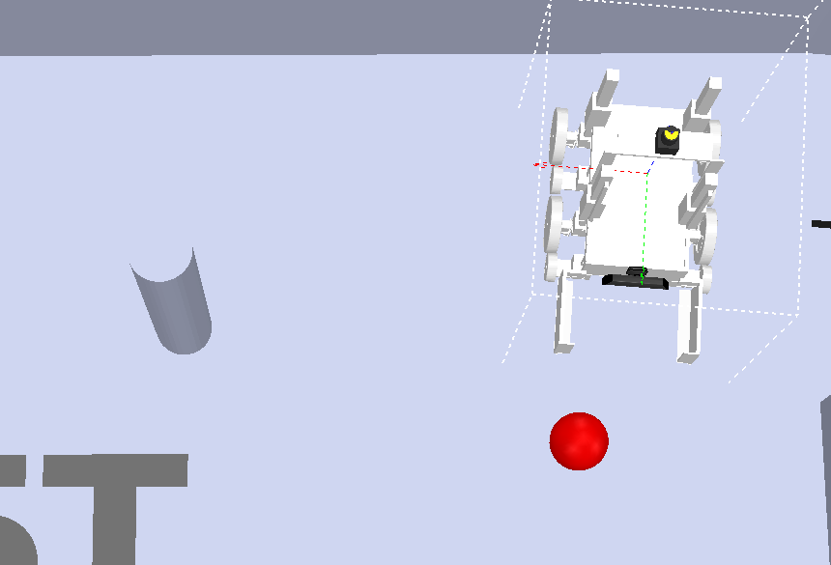
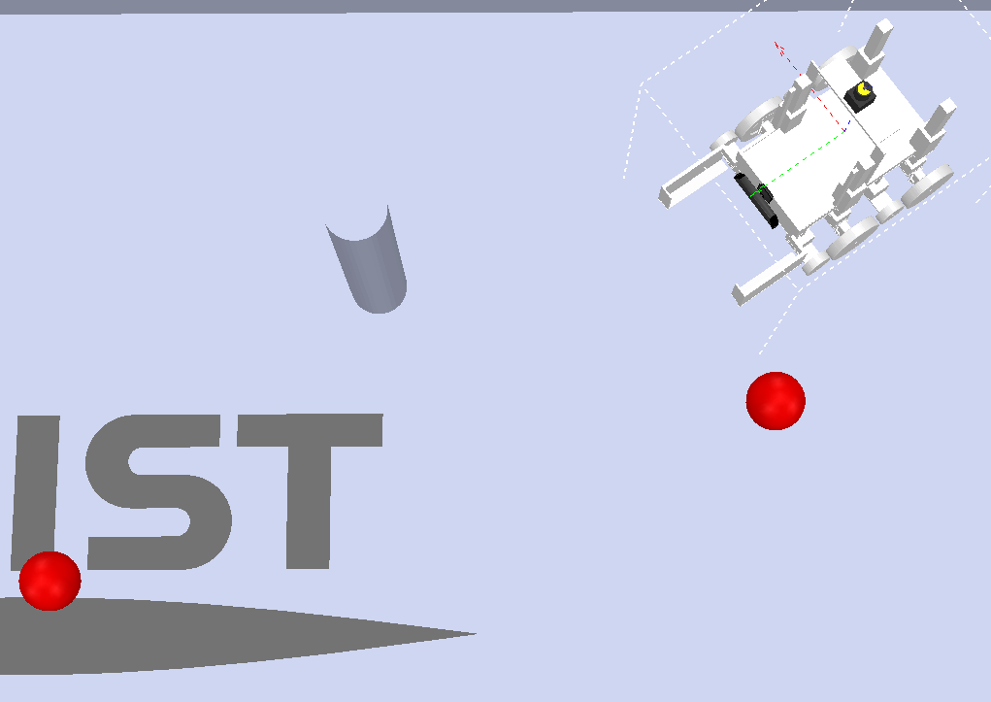
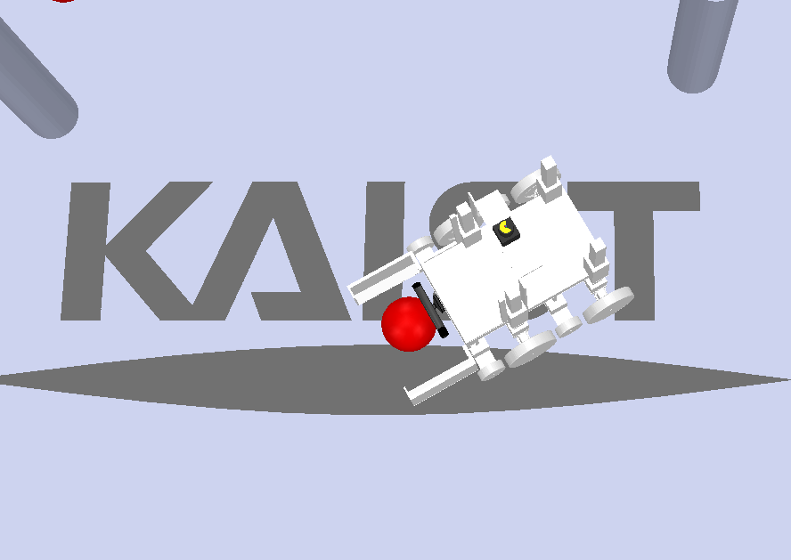
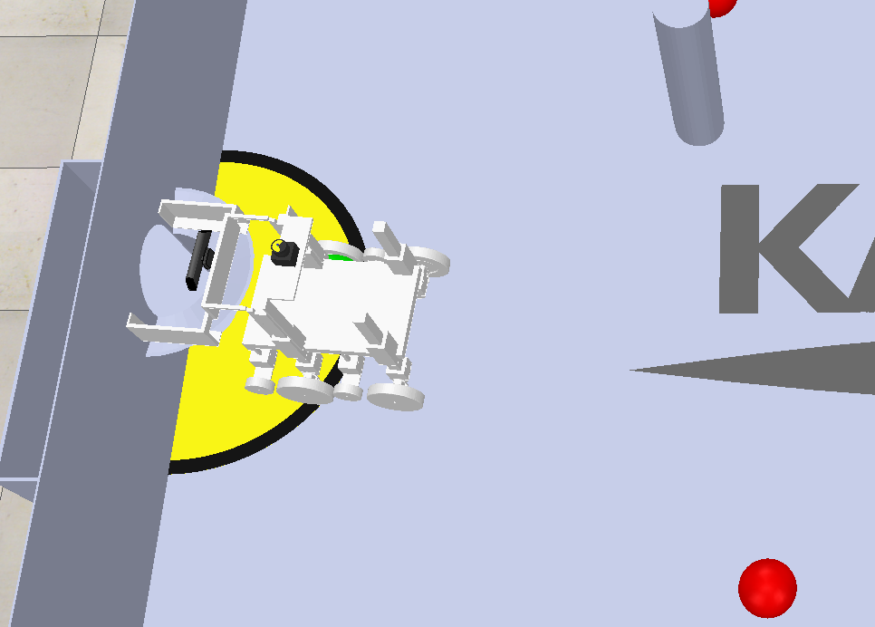
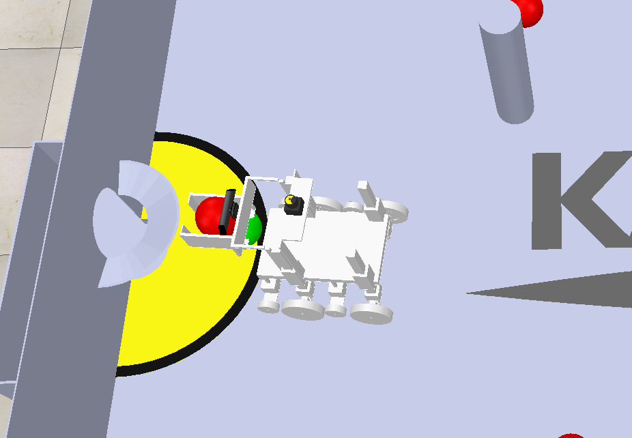
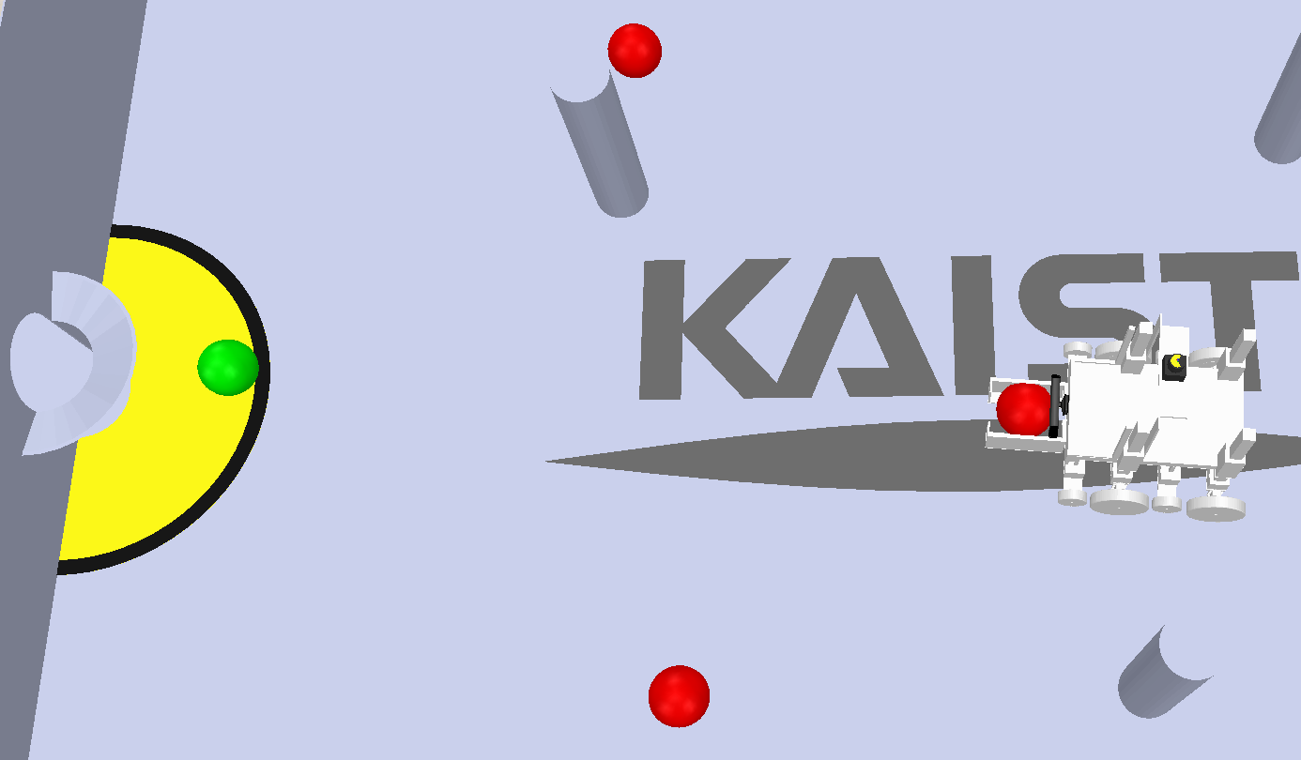
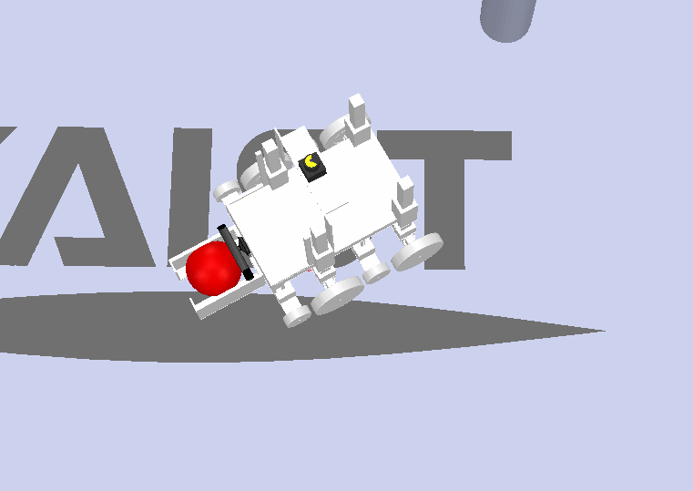
2-3. Path Finding
Initialize
Find Ball
Align
Approach
Avoid Obstacle
Goal In
Approach
Find Goal
Catch
Notes:
With those sensor data, we organized ball harvesting algorithm as follows.
This is sequential algorithm which iterates for 5 times.

Slide 24
2-3. Path Finding
Set best condition to find balls
Gripper wide open
Set wheel lift to the bottom
Set gripper lift to the bottom
Initialize
Turn until ball is detected
Ball detect node returns detected number of balls
If ball is detected, jump to the alignment
Find Ball
Notes:
First initialize the car,
Initializing makes the car get ready for collecting the balls.
For example, gripper should be opend wide, linear actuators should be set at the base position.
After that, car starts rotation to find red balls.

Slide 25
2-3. Path Finding
Distance
Angle
Data_Integration
Ball_Detect
Align
CW / CCW rotation
until ball is center positioned
Alignment
If ball gets out of the sight
: remember original direction
Approach
Precise Alignment
When car gets very close to the ball
Precisely align and reach the ball
Approach
Notes:
If the ball is found, car starts to align.
It rotates until the ball is center positioned, and then approach the ball.
If the ball gets out of the sight while approaching, ball conducts alignment again with it.
If car gets close enough to the ball, car conduct precise alignment again not to push the ball.

Slide 26
2-3. Path Finding
Catch
Find Goal
Initialize
Again !
Approach
Goal In
Notes:
After that is similar to what we did before, catch the ball, find green ball,
approach the green ball, lift the gripper and dump the ball.
After it finishes one cycle, it returns to the initializing function again and starts another cycle.
We made this robot to count the collected number of balls, so this will be repeated until no balls are left.

Slide 27
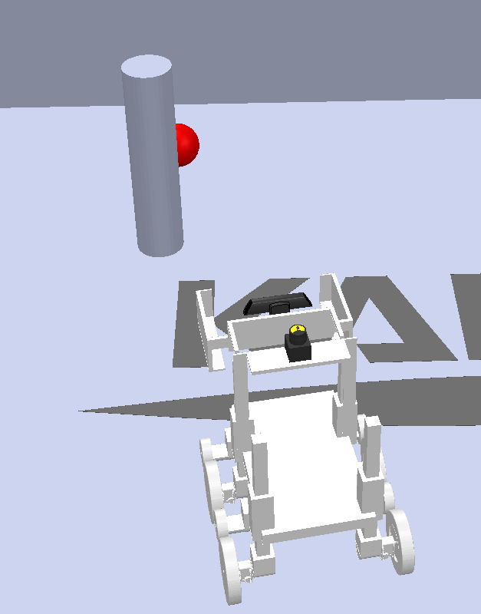
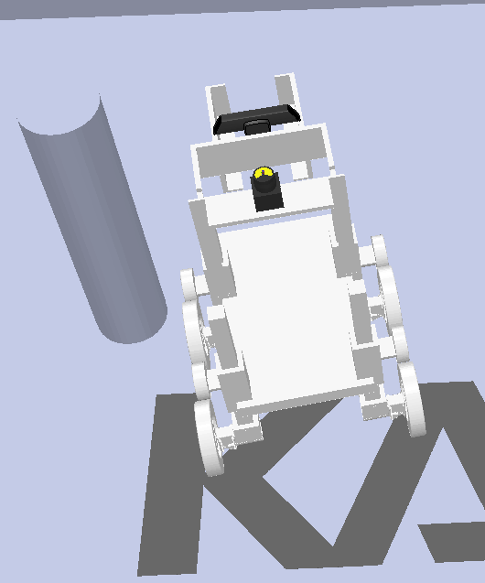
2-3. Exceptional Cases
Case 1
When path to the ball is blocked by obstacle
Case 2
When rotating, pole is disturbing the path
Compare position of ball and pole
Determine to detour right / left
Check closest pole distance < 0.5
If so, go front / back and conduct rotation again
Notes:
Because algorithm that I introduced before is too ideal and our map is quite complicated,
we faced many exceptional cases.
Exceptional handling was important in ball harvesting because it can prevent from miss handling and infinite loop.
First case is when path is inturrupted by pole.
With base algorithm, car just crashes the pole while approaching.
So after alignment we made car to check if there is pole on the path.
If the pole is blocking left side of the ball, car will avoid to the right side,
and if the pole is blocking right side of the ball, car will avoid to the left side.
Second case is when pole is disturbing rotation of car.
In this case, we made car to check the closest distance of the pole before the rotation.
If the distance is lower than 0.5, car moves front or back to get enough space.

Slide 28
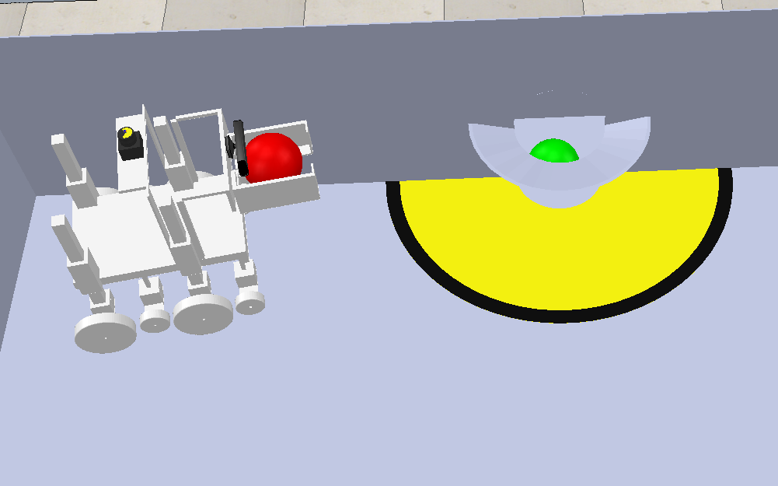
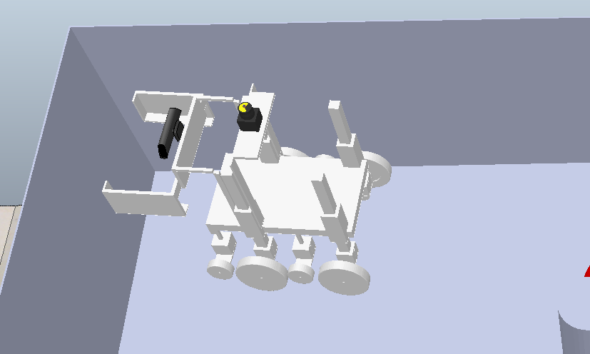
2-3. Exceptional Cases
Check distance to the wall < 0.5
If distance is lower, go away from the wall enough, and approach goal zone again
Case 3
When approaching the goal, wall is too close
Check the closest wall direction with lidar, and conduct corner escaping algorithm.
Case 4
When car is stuck in the corner
Notes:
Case 3 is when the car is blocked by wall while approaching the goal zone.
When car approaches the goal zone, car gets closer to the wall and finally crashes with wall.
So while approaching, we made car to check side distance to wall.
If this distance is lower than 0.5, car gets back from the wall enough and approach goal zone again.
Case 4 is when the car is stuck in the corner.
If car is continuously repeating one function for a long time, car conducts corner escaping algorithm.
It checks if it is surrounded by corner with lidar, it moves to the open direction and becomes free.
With these algorithms, we successfully conducted our objectives

Slide 29
Thank you Q&A
Notes:
Thank you for the listening, this is the end of our presentation

